Slide 1


Solace Performance Testing Harness
Christian Holtfurth
07/12/2017

Slide 2
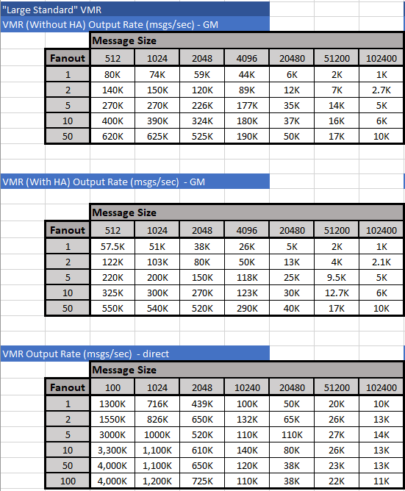
The Problem
The customer wants to know what kind of performance a broker can achieve on given infrastructure (on-prem/cloud)!
Gathering a full set of performance metrics on a broker takes a lot of time:
Lot of tests with varying message sizes and fan-out ratios as well as different message types
Each test needs to be run for a min amount of time to make sure we are not spooling etc.
Lot of virtual hardware sizes to choose from and run tests on
Sdkperf needs to be run across several hosts spreading traffic across several topics

Slide 3
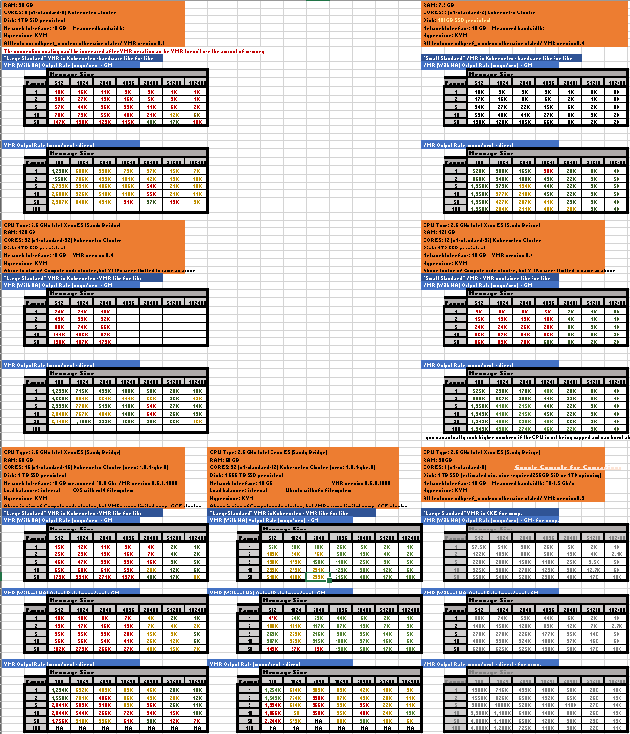
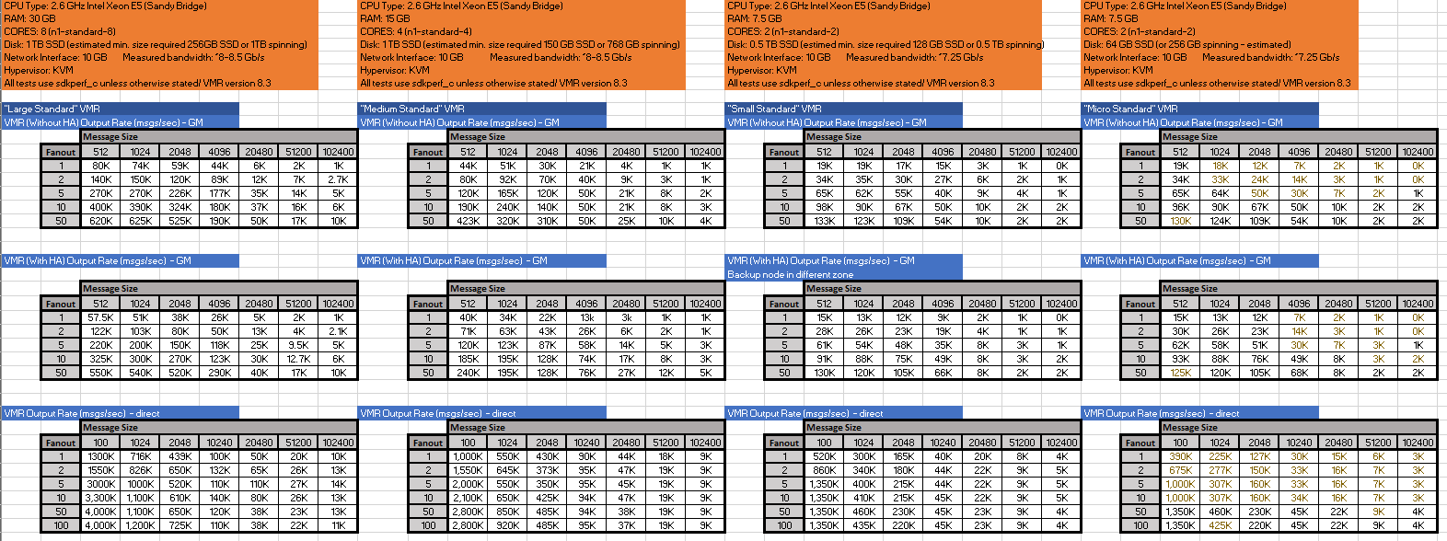
The Problem

Slide 4
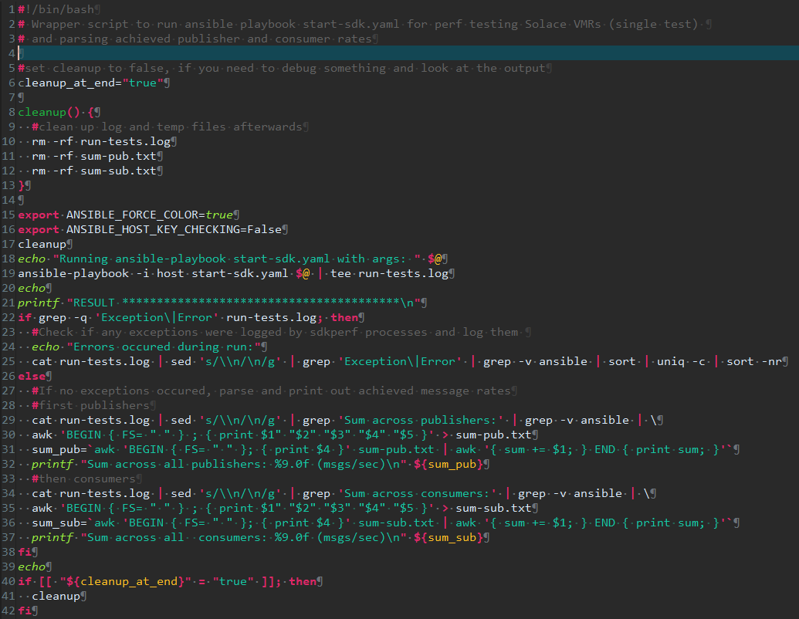
The Solution: Automate the hell out of it!!!
Use a combination of:
Timed sdkperf publisher and consumer scripts
Ansible playbook with asynchronous actions and polling to spin up sdkperf instances across several performance testing hosts and collect results
Some bash, grep, awk, sed script magic to collect and calculate results
Wrapper scripts to make it re-usable

Slide 5

Overview of test setup
Ansible host runs the main scripts and ansible playbook, which:
Pushes the Sdkperf files and scripts to the publisher and subscriber hosts
Starts the Sdkperf consumers and publishers in async jobs with a timer
Collects the results from all hosts and calculates the overall message throughput
Decides whether test is success or fail based on target throughput number
Ansible
Controller
Host
Pubhost1
Subhost1
Pubhost2
Subhost2
Pubhost3
Subhost3
Pubhost4
Subhost4

Slide 6
The Framework
Ansible Controller Host
Subhost
start-sdk.yaml
Ansible playbook
- Pushes sdkperf and scripts to pub/sub hosts
- Starts the sdk_consumers across all subhosts
with a timer in an async job
- Starts the sdk_publishers across all pubhosts
with a timer in an async job
(each host get a portion of the target msg
rate assigned = overall / no of hosts)
- Collects the output of all publisher and
consumers across all hosts
specific-test-sets/mytestset.sh
Defines up to 7 test arrays to run
with unlimited no of tests.
Each test sets parameters like:
- Msg size
- Fanout
- Target msg rate
- No of test hosts to use
- Msg type
- Prefix for logs/results
sdkconsumers.sh
- Starts number of requested sdkperf consumers and pins them to
cores (no of publishers * by fanout) in background
- Waits for timer to expire or Control-C, which is then caught to
gracefully kill the sdkperf jobs and allow for their output to be
written
- Collects the results for each sdkperf job and calculates sum
Pubhost
runtestset.sh
- Parses and breaks test set into
Individual test
- Collects output and calculates whether test was success/fail based on achieved/targeted rate and allowed error margin (default 5%)
sdkpublisher.sh
- Starts number of requested sdkperf publishers and pins them to
cores in background (each with a portion of the host target msg
rate = host rate / no of publishers)
- Waits for timer to expire or Control-C, which is then caught to
gracefully kill the sdkperf jobs and allow for their output to be
written
- Collects the results for each sdkperf job and calculates sum
run-tests.sh
Wrapper script around ansible
playbook:
- Calls ansible playbook
- Collects results from all hosts
- Calculates overall sum

Slide 7
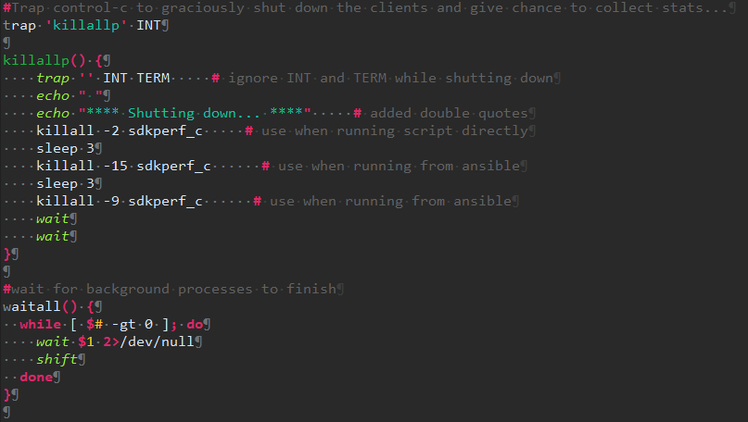
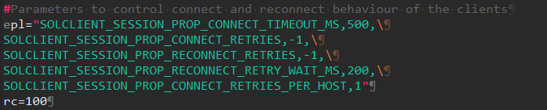
sdkconsumers.sh & sdkpublishers.sh

Slide 8
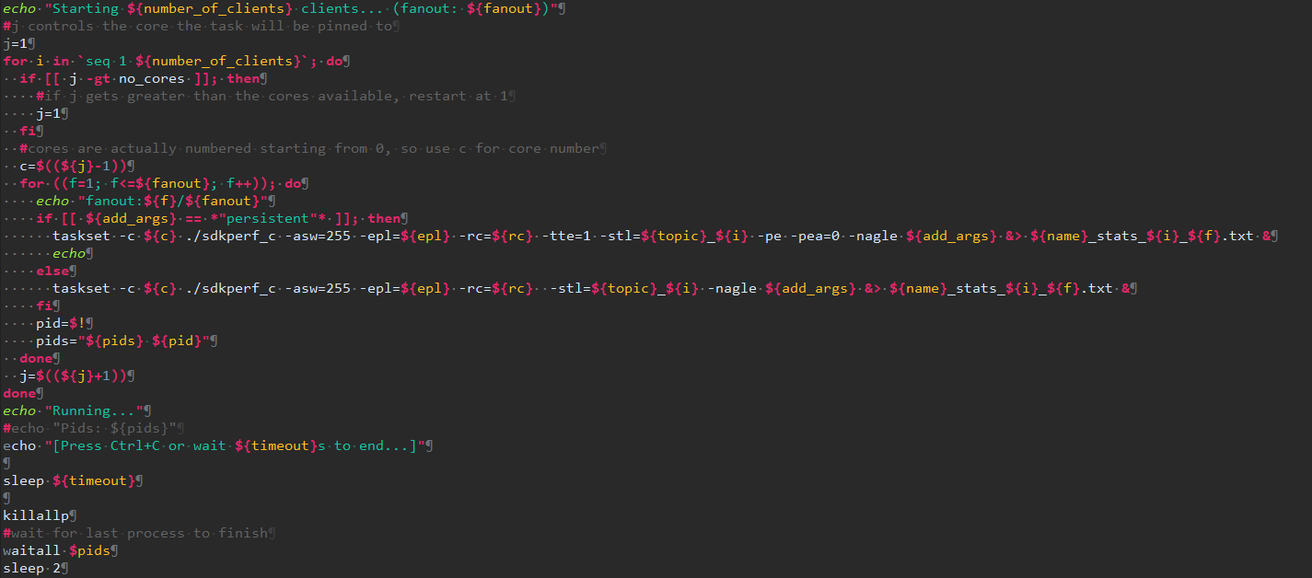
sdkconsumers.sh

Slide 9
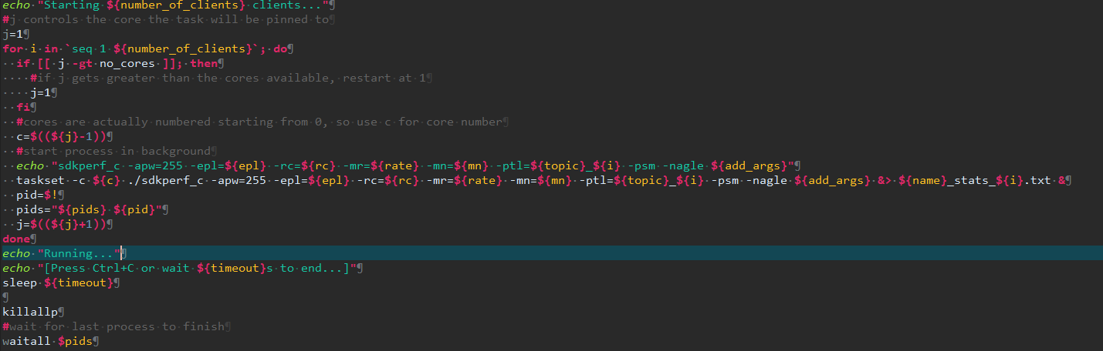
sdkpublisher.sh

Slide 10
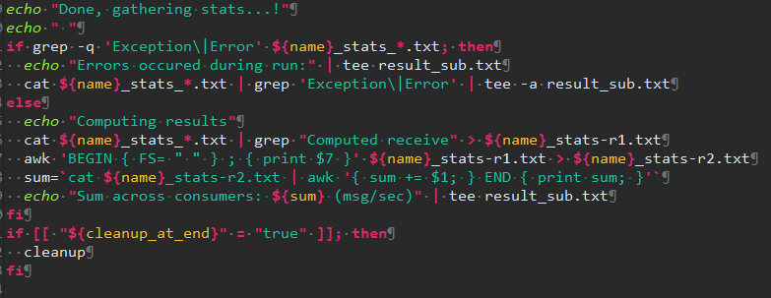
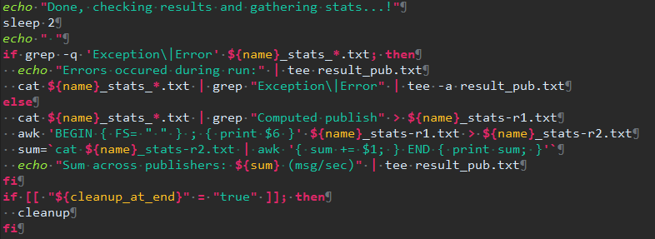
sdkconsumers.sh & sdkpublisher.sh

Slide 11
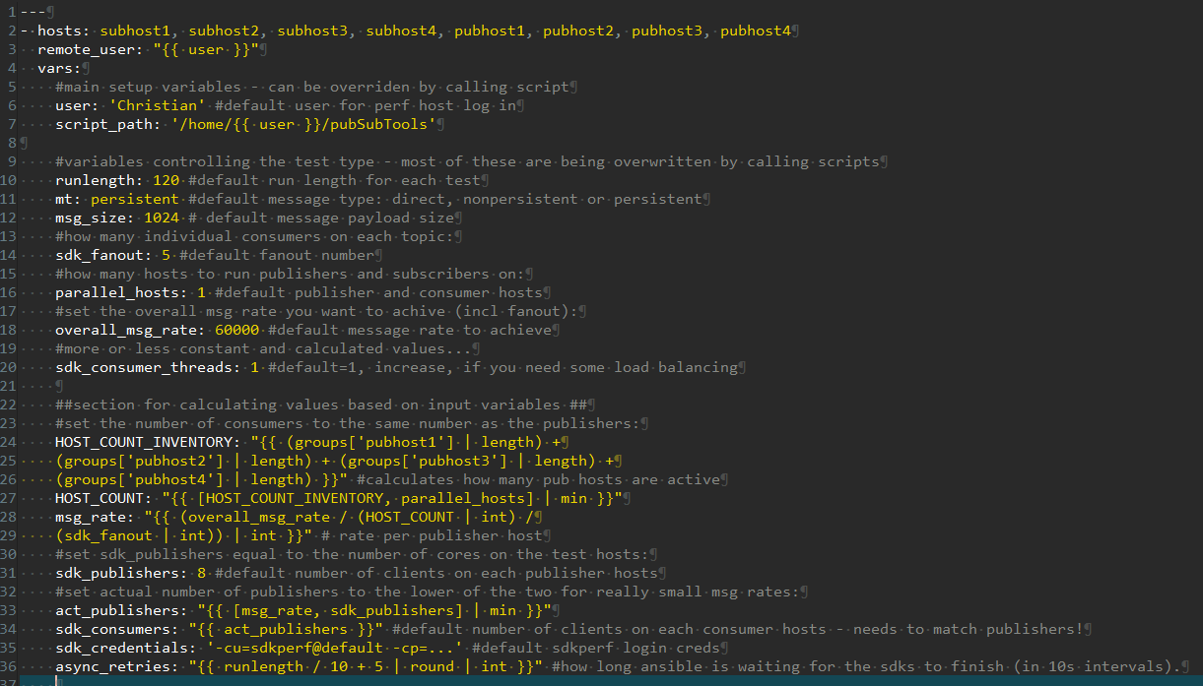
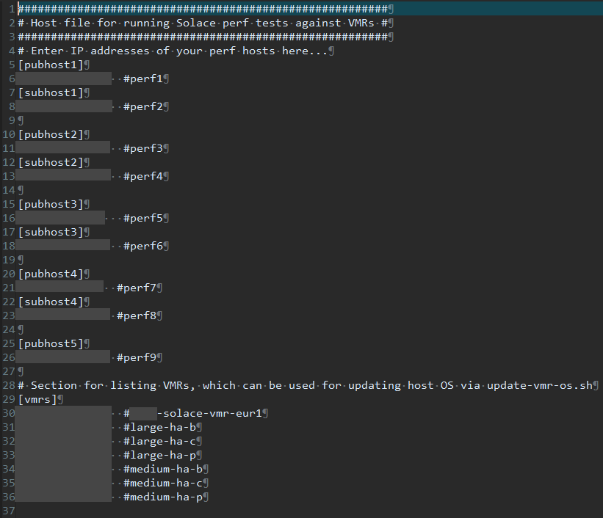
start_sdk.yaml

Slide 12
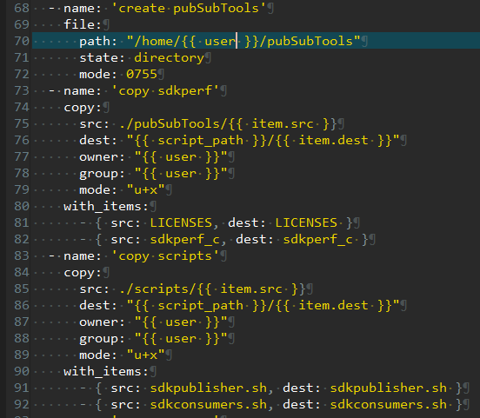
start_sdk.yaml
Just a bit of pre-test setup…
Create directories
Copy scripts over
Make them executable

Slide 13
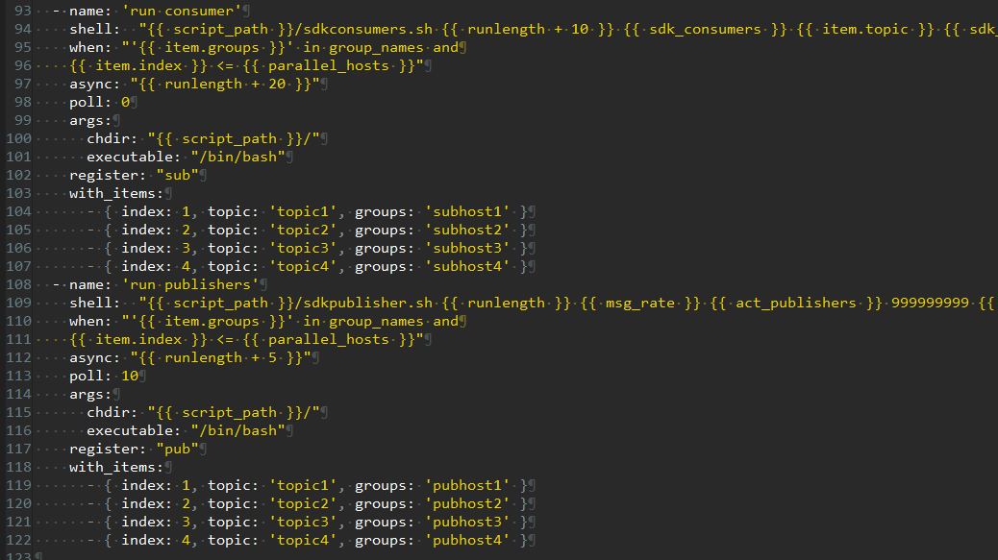
start_sdk.yaml
Starting sdks…
async with runlength
poll: 0 = fire & forget
poll: 10 = wait for it
item.index <= p. hosts
with_items: each host with different topic
register: to collect
output later

Slide 14
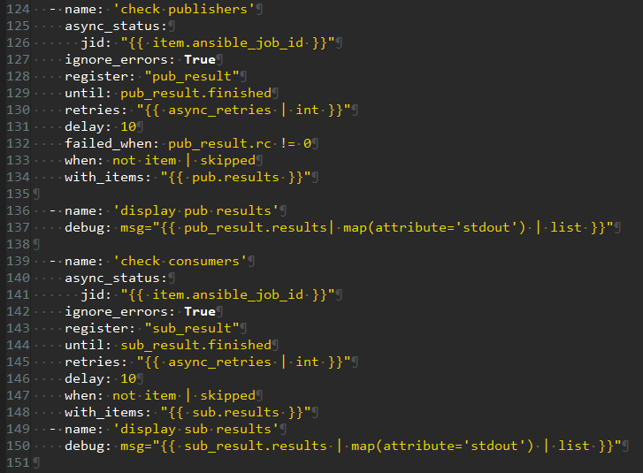
start_sdk.yaml
Collecting it…
Tries to collect the results of the async jobs every 10 s for a previously calculates no of time
Ignore_errors: True Don’t worry, we’ll do our error handling in the wrapper scripts

Slide 15
run-tests.sh
You have seen this before…
Just a wrapper around the ansible playbook for mainly:
Running a single test
Calculating overall throughput numbers
And: Error handling!

Slide 16
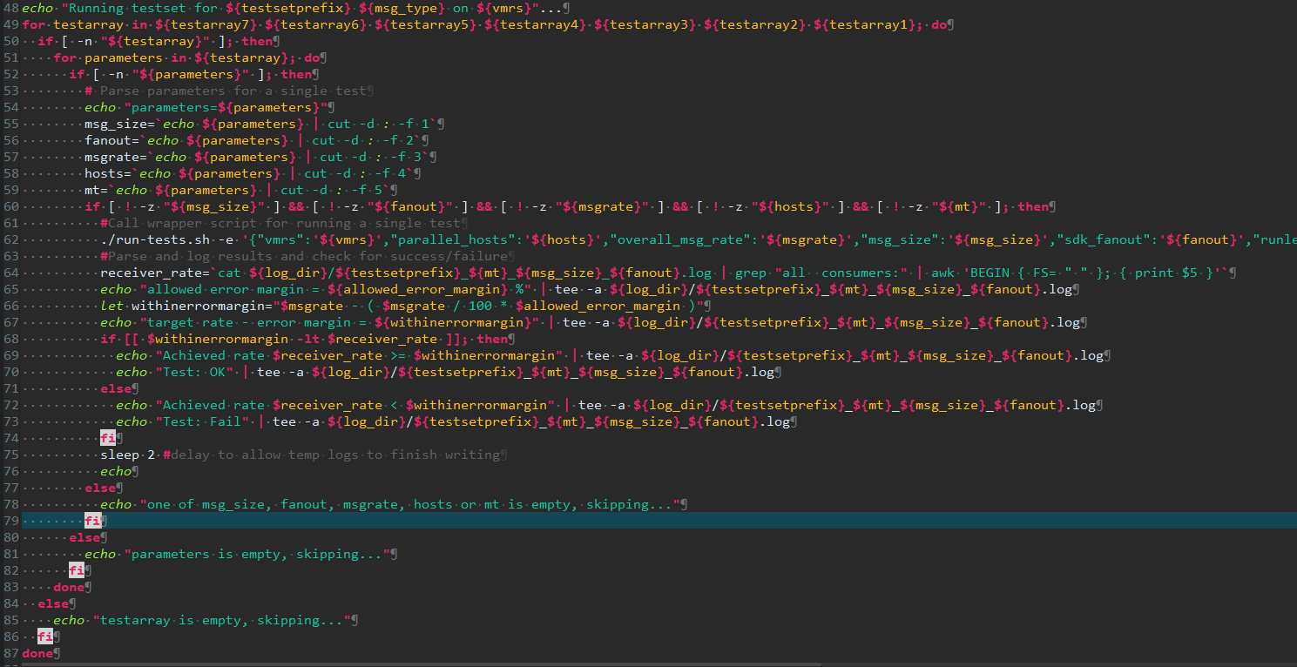
run-testset.sh
You have seen this before…
Just a wrapper around the ansible playbook for mainly:
Running a single test
Calculating overall throughput numbers
And: Error handling!

Slide 17
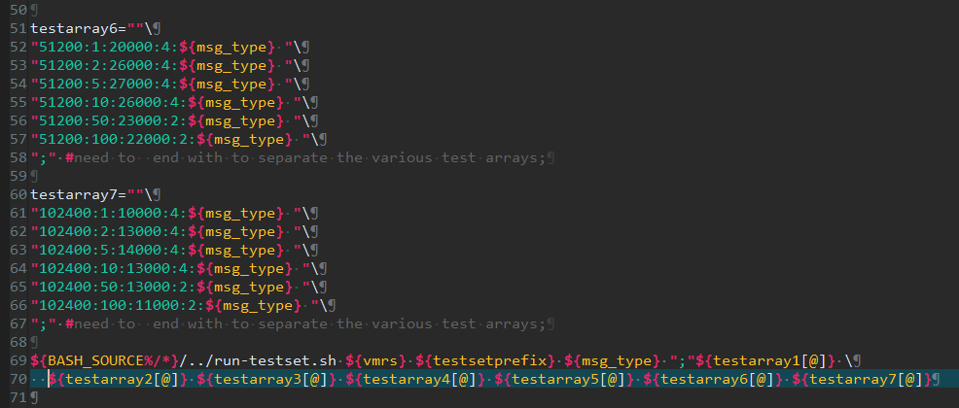
A specific test set script
And here you define the performance metrics you are trying to achieve…
Msg size
Fanout
Rate
Pub hosts
Msg type

Slide 18
read -p “Questions?" question
while [ ! -z “${question}”] ; do
answer ${question}
read -p “Next question?" question
done

